Slide 1

DATABASES AND APPLICATIONS
SUBJECT CODE : UQ23CA653A
Samyukta D Kumta
Computer Applications

Slide 2
DATABASES AND APPLICATIONS
UNIT-IV- Database Model-Network Model
Network Model in DBMS
In network model, the Hierarchical model is used to represent the many-to-many relationship among the database constraints.
It is a simple and easy-to-construct database model.
The Network Model in DBMS is based on the set theory (mathematical set theory), so the model of the database is constructed with the set of related records (data).

Slide 3
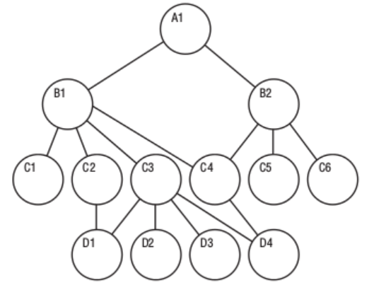
DATABASES AND APPLICATIONS
UNIT-IV- Database Model-Network Model
Structure of a Network Model in DBMS

Slide 4
DATABASES AND APPLICATIONS
UNIT-IV- Database Model-Network Model
The Structure of Network Model represents a network model in which there is the prime owner of the model
The network database model allows 1 : 1 (one-to-one), 1 : M (one-to-many), M : N (many-to-many) relationships among the entities or members.
The modeled hierarchal structure helps in avoiding data redundancy problems as there are multiple paths to the same record.

Slide 5
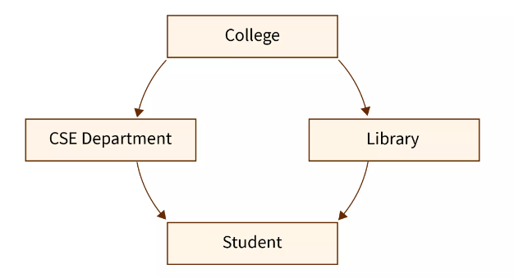
DATABASES AND APPLICATIONS
UNIT-IV- Database Model-Network Model
Structure of a Network Model in DBMS
Although the network model in DBMS is a hierarchal structure but is different from the hierarchal database model as there can be numerous parents of a member.

Slide 6
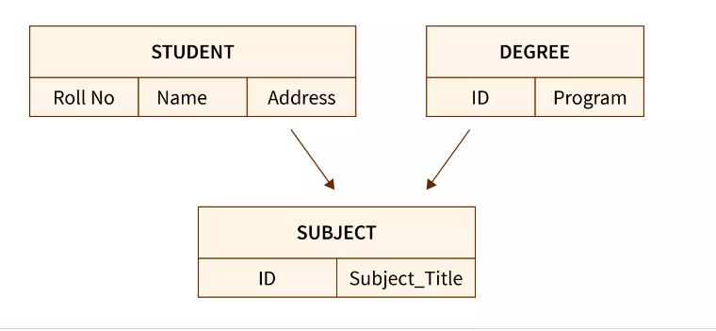
DATABASES AND APPLICATIONS
UNIT-IV- Database Model-Network Model
Example of Network Model

Slide 7
DATABASES AND APPLICATIONS
UNIT-IV- Database Model-Network Model
In network model for the Students database.
As we can see the Subject entity has a relationship with both the Student entity and the Degree entity. So there is an edge connecting the Subject entity with both Student and Degree.
The Subject entity has two parents and the other two entities have one child entity.
Other examples of the network model in DBMS can be:-
Store database (having relations between customers, manager, salesman, order, items, etc.).
Finance Department database (having relations between customers, products, invoices, payments, etc.).

Slide 8
DATABASES AND APPLICATIONS
UNIT-IV- Database Model-Network Model
Examples of Network Databases
Some of the famous network databases can be:-
TurboIMAGE
Integrated Data Store (IDS)
Raima Database Manager
Univac DMS-1100
IDMS (Integrated Database Management System), etc.

Slide 9
DATABASES AND APPLICATIONS
UNIT-IV- Database Model-Network Model
Characteristics of Network Model
The network model in DBMS is better than the hierarchical model as there are more interrelations between entities.
Supports various relationships such as one-to-one, one-to-many, and many-to-many as well.
An entity can have various parents or owners.
The connected structure results in high performance.
All the entities are interconnected with each other as a connected network.
The connected network of the database entities is represented in the form of a graph for better representation, workflow, and visualization.

Slide 10
DATABASES AND APPLICATIONS
UNIT-IV- Database Model-Network Model
Characteristics of Network Model
The network model in DBMS is not very flexible.
It is also quite a complex structure to deal with.
There can be more than one path to a certain record in DBMS which makes the data retrieval faster and simple.
The operations performed in the network database model using a circular linked list
The Network Model in DBMS does not support the query facility.

Slide 11
DATABASES AND APPLICATIONS
UNIT-IV- Database Model-Network Model
Experiential Learning
Convert Bank Relational Database model to Hierarchical Model
Convert plant Taxonomy ERD in Hierarchical model.
Write the advantages and disadvantages of Network Model
What are the operations can be performed on Network Model?
Write the difference between Hierarchical and network Model.

Slide 12

THANK YOU
Samyukta D Kumta
Department of Computer Applications
samyuktad@pes.edu

